Slide 1
Your NanoVNA and You
Everything you wanted to know,
but were afraid to ask!
David R Richardson, MLitt (S01369444)
K3KDR PHYS 501: Physics for Ham Radio, Rice University, Dr. Patricia Reiff
December 7, 2020

Slide 2
Overview
VNA basics
Origin of the NanoVNA
Practical use
As an antenna analyzer
Analyze a feed line
Find a fault in a damaged cable

Slide 3
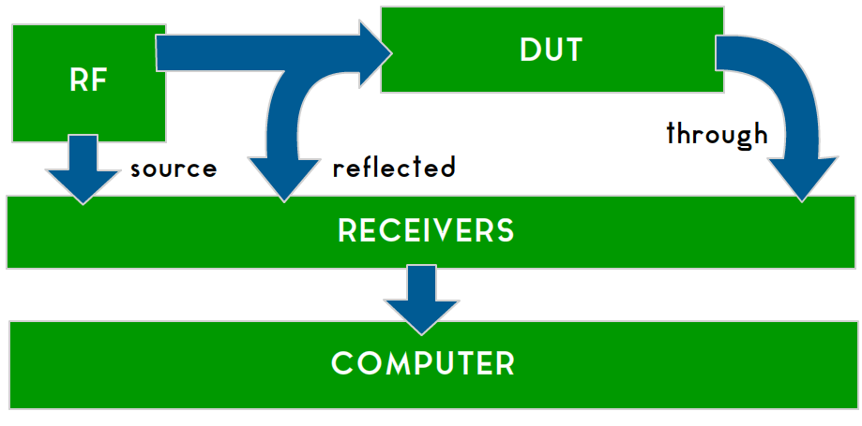
What’s a VNA?
Vector Network Analyzer
Measuring instrument
Generates a signal and measures the magnitude and phase of the reflected and output signals

Slide 4
What’s a VNA?
From just those two measurements
Reflection coefficient (S11)
Transmission coefficient (S21)
You can calculate
Return & Insertion loss
Complex Impedance
Resistance
Reactance
SWR
And more…

Slide 5
What can you do with it?
Analyze Antenna systems
Analyze filters
Perform a wide variety of cable measurements
Make phase-matched cables
Measure discrete components (inductors, crystals, etc.)
So much more…

Slide 6
Why is it so cheap?
VNAs are very expensive
Tens of thousands of dollars
The NanoVNA costs less than $100
Older models under $50
How is this possible?

Slide 7
Invented by a Ham
Designed by Thomas Baier DG8SAQ
Professor at University of Applied Sciences in Ulm, Germany
Published in the Mar/Apr 2007 issue of QEX
Updated in the Jan/Feb 2009 issue

Slide 8
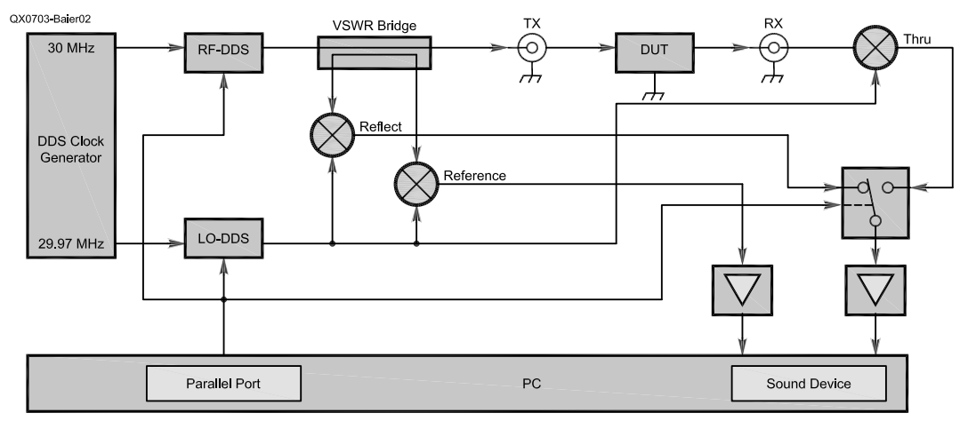
Invented by a Ham
http://web.archive.org/web/20100526025515/http://sdr-kits.net/DG8SAQ/VNWA/baier_VNWA10_QEX.pdf

Slide 9
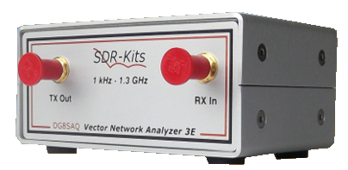
Invented by a Ham
Baier’s idea was to mix the signals down to AF and use a computer and sound card
This design was used in the VNWA, which Baier sold commercially for ~$500

Slide 10
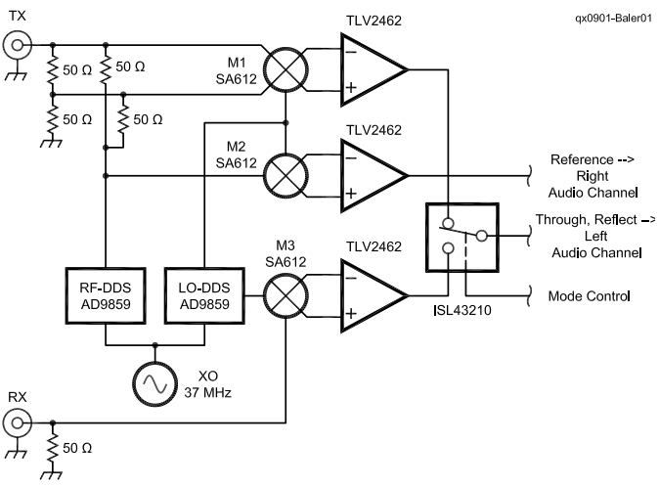
Invented by a Ham
https://www.sdr-kits.net/documents/Baier_VNWA2_QEX.pdf

Slide 11
NanoVNA
edy555 from Hokkaido, Japan significantly improved on Baier’s design
Everything, including the computer and display, fits on one small 3”x2” board
Modern components and Chinese manufacturing brought the price below $100

Slide 12
NanoVNA
edy555

Slide 13
NanoVNA
The product itself is completely “Open Source” – Including the hardware
Countless people from around the world have contributed to both the software and the hardware
This has lead to an explosion of improved designs

Slide 14
Variations
There are endless variations based on edy555’s design
The most popular at the moment is Hugen’s NanoVNA-H
The NanoVNA v2 is an all-new design by HCXQS in collaboration with OwOComm
Be careful to avoid poorly performing clones of the v2; there are tons of them. https://nanorfe.com/nanovna-v2.html

Slide 15
Is it any good?
No variation is going to replace a $50,000 machine
The results from even the original hardware are surprisingly accurate and more than adequate for amateur radio
The hardware and software are continually improving

Slide 16
Is it any good?
“…my excitement grew tremendously to compare it with the Keysight FieldFox N9952A 50GHz VNA. After achieving comparable results, my happiness knew no bounds…”
--Salil Tenbe
nuclearrambo.com
This guy added TDR simulation
He’s also a ham!
VU3XEN

Slide 17
Limitations
101 samples
100kHz – 1Ghz
Precision starts to fall-off around 300MHz, though it’s fine under 500Mhz.
Keep the calibration range as small as you can.
Be careful if you’re near a strong signal
Things have improved dramatically in v2

Slide 18
Let’s try it out!

Slide 19
Out of the box
SWR
Smith Chart
Phase
“Logmag” (return loss & insertion loss in dB)

Slide 20
Out of the box
The easiest and most obvious use for most hams will be the SWR and Smith Chart features
If you’re just looking for an antenna analyzer, you simply can’t get anything better for the price.

Slide 21
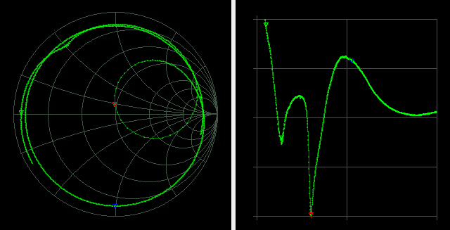
Smith Chart & SWR
Smith Chart
SWR
Red marker shows resonant point. Blue marker is at -90° Phase
Range is 3MHz-15Mhz
1010 samples (using NanoVNA Saver)

Slide 22
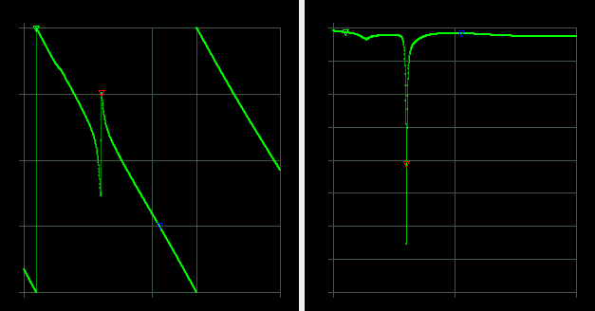
Phase & Return Loss
Phase
Return Loss
Red marker shows resonant point. Blue marker is at -90° Phase
Range is 3MHz-15Mhz
1010 samples (using NanoVNA Saver)

Slide 23
Cable Measurements
Characteristic Impedance
Velocity Factor
Cable Length
Distance To Fault

Slide 24
Characteristic Impedance
To find a cable’s characteristic impedance, we need to take two measurements.
Remember that
We’ll measure from a single frequency.

Slide 25
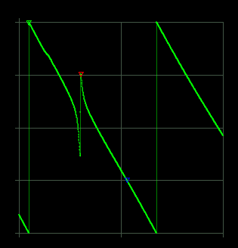
Characteristic Impedance
I read from a point where the phase was -90 degrees as it was far away from the resonant point.
Red marker shows resonant point.
Blue marker is at -90° phase
Range is 3MHz-15Mhz
1010 samples (using NanoVNA Saver)

Slide 26
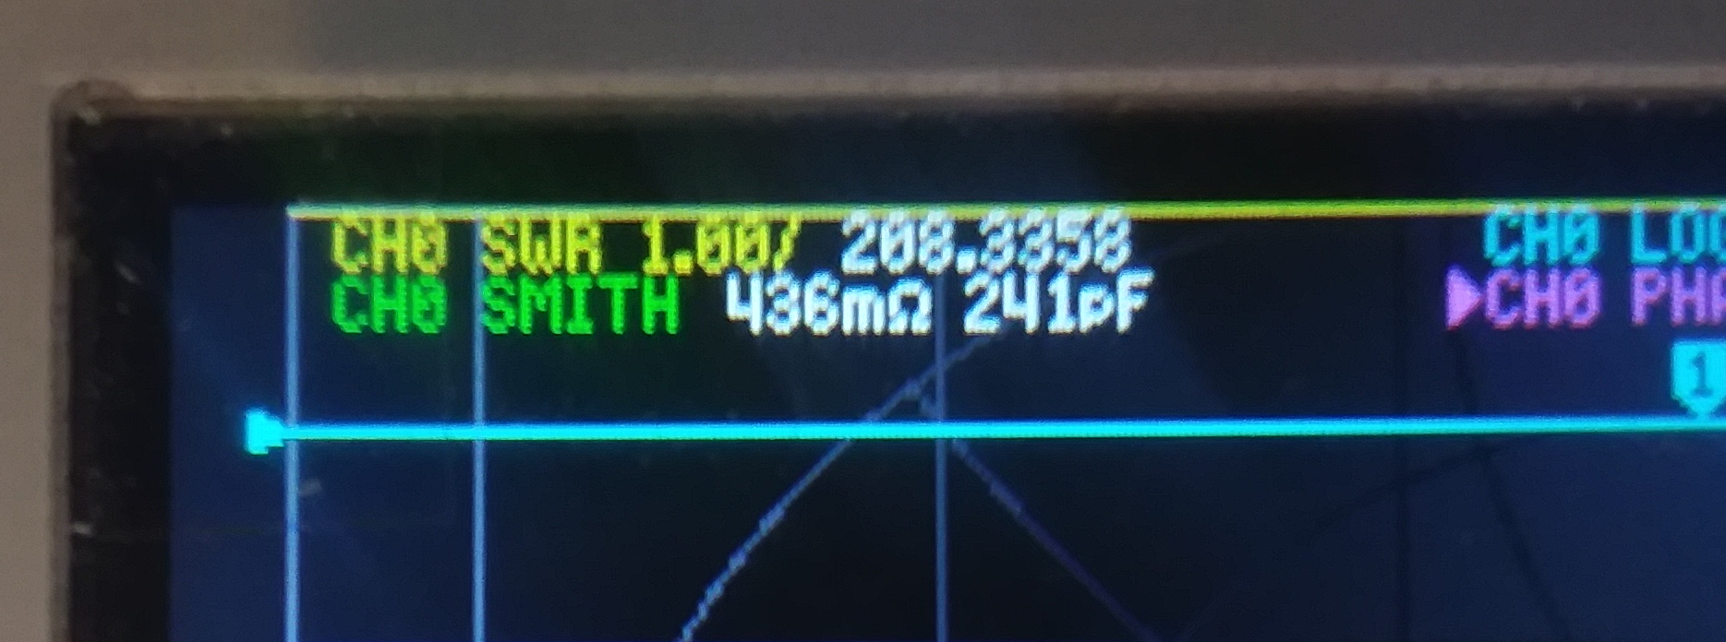
Characteristic Impedance
Using the Smith chart, read capacitance with the cable open. My junk cable reads 241pF
Short the cable and read the inductance. My junk cable reads 596nH

Slide 27
Characteristic Impedance
Not bad at all. We’re about as close to 50ohm as we could hope.

Slide 28
Velocity Factor
Velocity factor (velocity of propagation) is a measure of the speed a wave propagates through a medium. A feed line, in our case.
This value is expressed a fraction of the speed of light in a vacuum (a percentage or a value between 0 and 1)
It’s important to have an accurate value for single-port cable length and DTF measurements

Slide 29
Velocity Factor
A signal from port 1 (CH0) travels through the cable and appears at port 2 (CH1)
Traveling through the cable takes time, which will show up as a difference in phase
As this measurement requires the use of both ports, you must perform the ‘isolation’ and ‘through’ calibration steps.

Slide 30
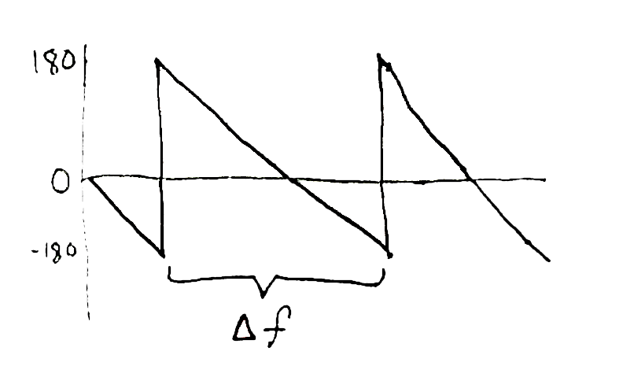
Velocity Factor

Slide 31
Velocity Factor
Once you have the delta frequency, you can find out how long the cable would be if the signal propagated at the speed of light. (The electrical length)
Using the same junk RG-58/U cable from before, I measured 51.039MHz and 151.225MHz giving a delta of 100.186Mhz
I had to zoom in on each point of interest to get a more accurate measurement.

Slide 32
Velocity Factor
The cable isn’t almost 3 meters long. It’s only 74.5” or 1.892 meters long. We can find the velocity factor of our cable with a quick division.
Just below the expected 0.66

Slide 33
Cable Length
Now that we know the velocity factor, we can measure the cable length a few different ways
One way is to use the same two-port measurement we used to find the velocity factor. Just multiply the electrical length by the velocity factor to get the real length.
If you don’t have access to both ends of the cable, we need a different approach…

Slide 34
Cable Length
Time Domain Reflectometry (TDR) is a common feature of expensive VNAs.
The NanoVNA does everything in the frequency domain and doesn’t have a “real” TDR mode.
We can simulate it in software, thanks to the power of math!

Slide 35
Cable Length
We need data in the time domain, and the return loss data is in the frequency domain
The basic idea is to apply an inverse Fourier transform to the return loss data. It’s just a bit of arithmetic from there.
This is handled in the v2 and newer firmware releases. The NanoVNA Saver software also has this feature, and it’s significantly easier to use than the firmware.

Slide 36
Cable Length
Using NanoVNA Saver with one end of the cable connected to port 1 (CH0)
Connect to the NanoVNA and run a Sweep
Set the Velocity Factor under “Time Domain Reflectometry” and read the result
I could not get a measurement on the built-in display using the latest firmware on the original hardware. (A later model such as the v2, F, or H may be required.)

Slide 37
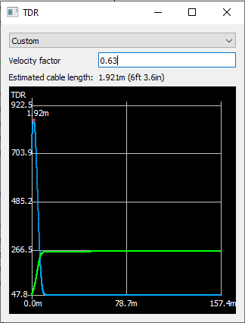
Cable Length
Using our measured VF, the error is less than 3cm
Using the expected VF of 0.66 instead, the error is almost 12cm!
Don’t trust the specs

Slide 38
Distance To Fault
We can use the same single-port cable length measurement to find a fault in a cable
I used a scrap cable, identical to the junk cable we used earlier, that I had cut to make a jumper.
I attached an additional 21.75” of cable at the shield to simulate a cable with a break in the center conductor

Slide 39
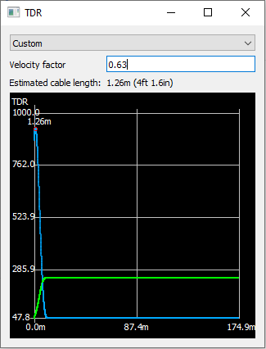
Distance To Fault
The break was at exactly 50”
The fault was found at 49.6”
Error of less than ½ inch!

Slide 40
Conclusion
The NanoVNA is an impressive instrument that will only get better with time
It’s as empowering as it is inexpensive
It can replace some common instruments
It has a wide variety of uses in the ham shack
It will soon be considered essential

Slide 41
References
Thomas C. Baier, DG8SAQ, "A Low Budget Vector Network Analyzer for AF to UHF", QEX, Mar/Apr 2007, ARRL, pp 46-54 http://web.archive.org/web/20100526025515/https://mydarc.de/DG8SAQ/VNWA/
Thomas C. Baier, DG8SAQ, "A Small, Simple, USB-Powered Vector Network Analyzer Covering 1 kHz to 1.3 GHz", QEX, Mar/Apr 2009, ARRL, pp 32-36 https://www.sdr-kits.net/documents/Baier_VNWA2_QEX.pdf
Thomas C. Baier, DG8SAQ, "Letters to the Editor, A Low Budget Vector Network Analyzer for AF to UHF", QEX, Jul/Aug 2007, ARRL, pp 1-3 http://web.archive.org/web/20100326100318/http://sdr-kits.net/DG8SAQ/VNWA/QEX-Letters.pdf

Slide 42
References
BH5HNU, "NanoVNA-F Handheld Vector Network Analyzer Incomplete Manual", 2020-01-08, Hangzhou Minghong Electronic Technology Co., Ltd., https://www.deepelec.com/files/NanoVNA-F_Handheld_Vector_Network_Analyzer_Incomplete_Manual_v1.0.pdf
IMSAI Guy, "NANOVNA Demystified", 2020-07-26, https://www.youtube.com/watch?v=yGKWBpgN8PU
Gregg Messenger, VE6WGM, "nanoVNA - Characteristic Impedance Measurement Methods - Testing 75 Ohm Coax", 2020-07-07, https://www.youtube.com/watch?v=8c13PPA51zs

Slide 43
References
Gregg Messenger, VE6WGM, "nanoVNA - Coaxial Cable Measurement Methods (Characteristic Impedance and Cable Loss)", 2020-07-07, https://www.youtube.com/watch?v=G66_iqOu-Bs
OwOComm, “NanoVNA V2 Users Manual”, 2020-09, https://nanorfe.com/nanovna-v2-user-manual.html
Salil Tenbe, VU3XEN, "Accurately measuring cable length with NanoVNA", 2019-08-18, https://nuclearrambo.com/wordpress/accurately-measuring-cable-length-with-nanovna/
Salil Tenbe, VU3XEN, "Comparing NanoVNA with the Keysight Fieldfox N9952A", 2019-08-13, https://nuclearrambo.com/wordpress/comparing-nanovna-with-the-keysight-fieldfox-n9952a/

